Slide 1
Online Examination Portal
Team member
Adarsh
Akash
Faiz

Slide 2
Introduction
Online examinations are an important method of evaluating the success potential of students. This research effort the individuals under consideration were students who would be enrolling in computer courses or Technologies Registrations. A prototype of a web-based placement examination system is described from the standpoint of the research effort, end user, and software development.

Slide 3
Analysis
1.1 System Analysis
1.2 System Specification

Slide 4
1.1 System Analysis
Existing System:
Existing system is a manual one in which users are maintaining books to store the information like Student Details, Instructor Details, Schedule Details and feedbacks about students who attempted exam as per schedule.. It is very difficult to maintain historical data.
Disadvantages:
Lots of copies of questions have to be made, lots of corrections, hence delays the result time and last is lots of tabulation for each subject

Slide 5
1.2 System Specifications
Hardware Requirements:
Pentium 4(processor)
256mb RAM
512 kb cache memory
Hard disk 10 GB
Microsoft Compatibility
Software Requirements:
OS : Windows
Web technology : PHP
Front End : HTML, CSS, JavaScript
Back End : MySQL, Python
Web Server : Apache Server, jupyter server
Modules : OpenCV, Numpy, Panda, Scikitlearn,

Slide 6
Modules in portal
There will be three types of modules in this system:
Student Module
Teacher Module
Admin Module

Slide 7
Student’s module
This module contain:
Registration : To authenticate first you have to be registered.
Login : Registered user need to authenticate to see the inner details.
Take Exam : Multiple Choice Question(MCQS), True/ False. Where student is required to take the examination
Result of Exam : Can see the result after examination.
Logout : Logout the authentication after examination or some work.

Slide 8
Teacher’s Panel
1.REGISTER : To be authenticated first have to be registered.
2.LOGIN : The Registered User Can be Allowed to view inner details for which he Permitted
3.CHANGE PASSWORD : User has rights to modify his logging details& also be informed through mails if he is unable to login
4.ADD QUESTIONS-DEPARTMENTS VERIFING : According to flow of questions & Technology he can add questions into the database.
5.UPDATE QUESTIONS -DEPARTMENTS VERIFING : If any corrections in data of questions he can modify them
6.CREATE EXAMS : He will be prepared schedule for exams periodically.
7.UPDATE EXAMS : He has rights to modify exam schedule.
8.VIEW EXAM DETAILS : VIEW NO OF REGISTERED STUDENTS, VIEW NO OF ATTENDED STUDENTS
9.EVALUATE QUESTION:MULTIPLE CHOICE TRUE/FALSE : Evaluation of marks based on his initiations when adding questions.

Slide 9
Admin Panel
1.REGISTER : To be authenticated first have to be registered.
2.LOGIN : The Registered User Can be Allowed to view inner details for which he Permitted
3.CHANGE PASSWORD : User has rights to modify his login details & also be informed through mails if he is unable to login.
4.STUDENT -MODIFING DETAILS : User can be modified to change status of each User.
5.DEPARTMENTS-ENTERING/MODIFYING DETAILS : New departments adding and old department deletions are spend by this user
6.INSTRUCTOR DETAILS-MODIFYING DETAILS : According to staff he can add or delete Instructors for specific platforms.

Slide 10

Adding Machine learning Concept
The Project consist of analysis of results from the score.
KNN(k-Nearest Neighbour) can be best algorithm for this analysis.

Slide 11
K-Nearest neighbour
K nearest neighbours is a simple algorithm that stores all available cases and classifies new cases based on a similarity measure (e.g., distance functions). KNN has been used in statistical estimation and pattern recognition already in the beginning of 1970's as a non-parametric technique.

Slide 12
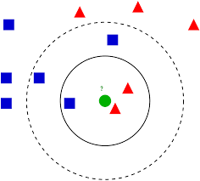
More on knn algorithm
The k-nearest neighbours (KNN) algorithm is a simple, supervised machine learning algorithm that can be used to solve both classification and regression problems. It's easy to implement and understand, but has a major drawback of becoming significantly slows as the size of that data in use grows.

Slide 13
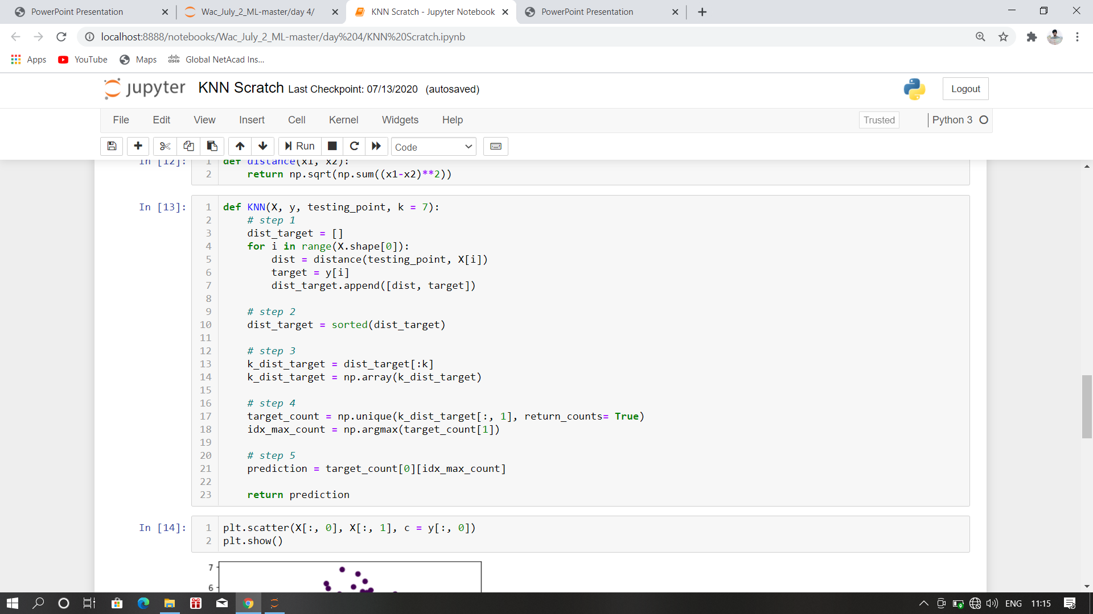
KNN Program

Slide 14
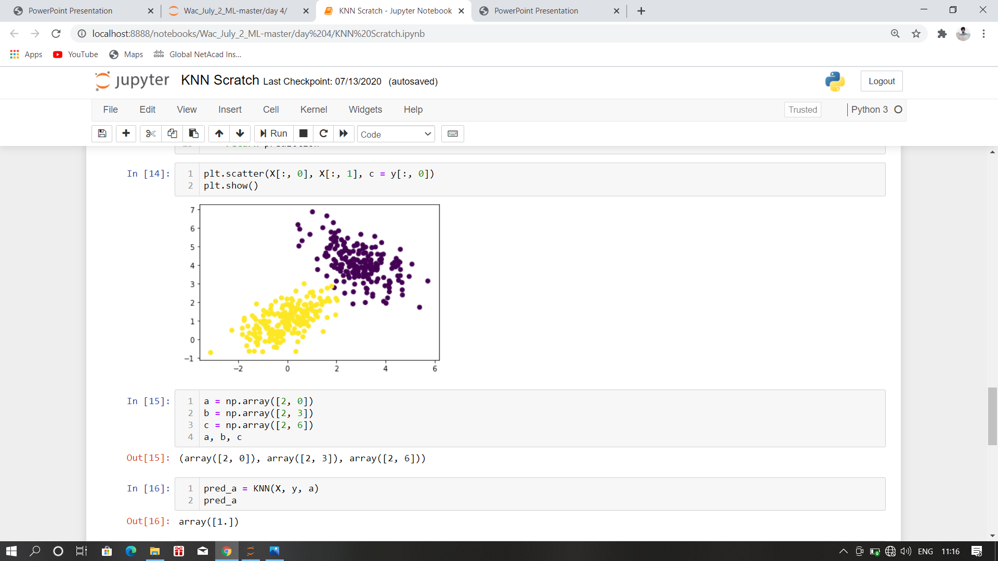
KNN Plotting

Slide 15
Algo for Adding face (Overview)
Step 1 : Import OpenCV, and numpy
Step 2 : Loading the Cascade File
Step 3 : Now Enter the Name of person
Step 4 : Using Cascade File use face Recognition for taking the data set of that person
Step 5 : Now Add these these images in .npy file format

Slide 16
Adding face in details
Step 1 : Importing all the important Modules which are required in running the Project
Step 2 : Using OpenCV package cv2.VideoCapture we have to initialize the camera with some variable lets say cap
Step 3 : Using the predefine cascade file named as "haarcascade_frontalface_alt.xml" with cv2.CascadeClassifier to be stored in variable lets say face_cascade for face detection
Step 4 : Use While loop until it get terminate
Step 5 : Enter the camera mode and make the image in cv2.COLOR_BGR2GRAY format which is basically grey format
Step 6 : Check if there is face then Continue
Step 7 : else jump to Step 12
Step 8 : Set the Frame to 1.3 and save this image as the name given by the user
Step 8 : Store this file in './data/' folder
Step 9 : Inside this folder add the file which should be name as "User_name".npy format
Step 10 : If the user click nothing then jump to Step 4
step 11 : If the user click q from the keyboard then jump to Step 12
Step 12 : Terminate the Program
Step 13 : Finish

Slide 17
Detecting face (Overview)
Step 1 : Import The OpenCV, numpy, and OS
Step 2 : Now Run the Program
Step 3 : Using KNN algorithm from the trained set of data Start check the matching of Face
Step 4 : If the face matches the face available in data set, then start showing the face with name on the top
Step 5 : Else name will not be able to show on the face

Slide 18
Detection Face using knn
Step 1 : Importing all the important Modules which are required in running the Project
Step 2 : Using OpenCV package cv2.VideoCapture we have to initialize the camera with some variable lets say cap
Step 3 : Using the predefine cascade file named as "haarcascade_frontalface_alt.xml" with cv2.CascadeClassifier to be stored in variable lets say face_cascade for face detection
Step 4 : Creating Datapath as string './data/' inside the variable dataset_path
Step 5 : Creating two empty list face_data and Labels and also initializing the variable class_id and name as an empty dictionary
Step 6 : Starting for loop in dataset_path
Step 7 : Adding all the data in the data from that folder which ends with .npy and making a dictionary with key as incremental class_id and value as facedata of specific person
Step 8 : Creating a labels for class
Step 9 : End for loop
Step 10 : Creating a function Distance(v1,v2)
Step 11 : return Euclidien formula i.e sqrt(((v1-v2)**2).sum())
Step 12 : End of Step 10
Step 13 : Creating Function KNN(train, test,k =5)
Step 14 : Initilizing dist as empty list

Slide 19
Detection Face using knn(continue)
Step 15 : for i in range(train.shape[0]):
Step 16 : Get the vector and label ix = train[i, :-1] iy = train[i, -1]
Step 17 : Compute the distance from test point d = distance(test, ix) dist.append([d, iy])
Step 18 : Sort based on distance and get top k dk = sorted(dist, key=lambda x: x[0])[:k]
Step 19 : Retrieve only the labels labels = np.array(dk)[:, -1]
Step 20 : Get frequencies of each label output = np.unique(labels, return_counts=True)
Step 21 : Find max frequency and corresponding label index = np.argmax(output[1])
Step 22 : return output[0][index]
Step 23 : End of Step 13

Slide 20
Labeling the name on image(continue)
Step 24 : creating variable trainset = np.concatenate((face_dataset,face_labels),axis=1) for comparing the face for the dataset
Step 24 : Using while loop until it get terminate
Step 25 : If there is face on the screen then create for loop with the number of faces
Step 26 : Else jump to Step 32
Step 27 : Check the offset of the image for the cap from Step 2
Step 28 : Prediction Label jump to Step 13 with trainset and face_section as arguments

Slide 21
For displaying the name on rectangular box of image
Step 29 : Display on the screen the name and rectangle around it pred_name = names[int(out)] cv2.putText(frame,pred_name,(x,y-10),cv2.FONT_HERSHEY_SIMPLEX,1,(255,0,0),2,cv2.LINE_AA) cv2.rectangle(frame,(x,y),(x+w,y+h),(0,255,255),2)
Step 30 : If the user click nothing then jump to Step 24
Step 31 : If the user click q from the keyboard then jump to Step 32
Step 32 : Terminate the program
Step 32 : Finish

Slide 22
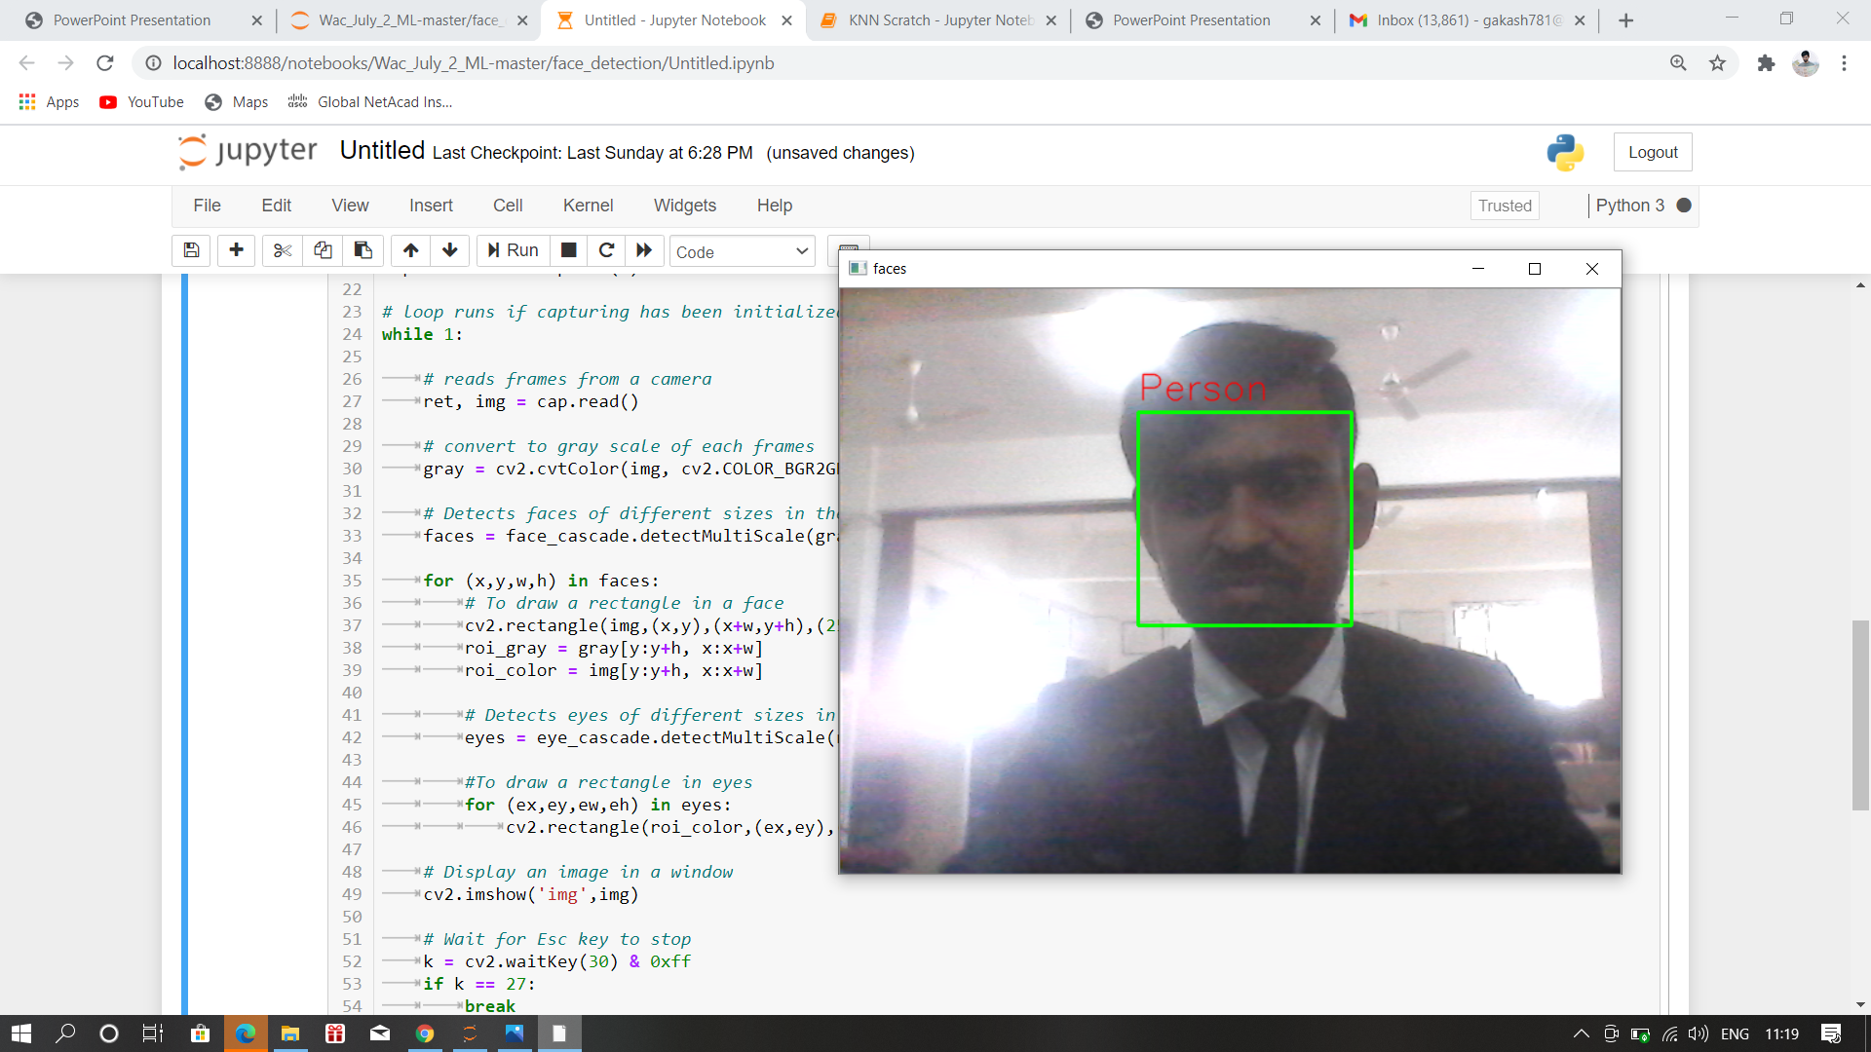
Screenshot of working prototype

Slide 23
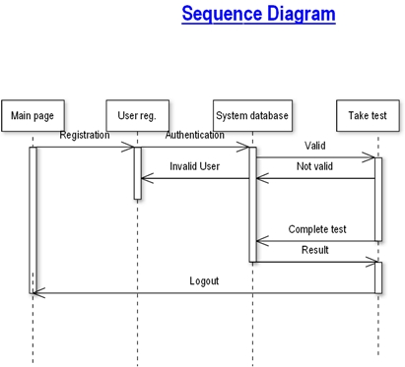
How it works!

Slide 24
Use of ML in our project
For Report Analysis
For Web Proctored using Face Recognition System

Slide 25
Face Recognition System
This will help us to detect the authenticity of the person
Will help in real time check of person whether he/she is sitting in the examination of not
Help use in detecting the person whether he/she is trying to cheat or not.

Slide 26
Advantages of Online Examination
It saves paper. You never have to print an exam for your students and hand them out. Saves paper. Saves trees. Everybody happy.
It saves time. You can setup an exam in such a way that it will auto-grade itself. If you only use multiple choice questions you never have to check an exam again. The online exam system will take care of that hassle. Completely automated.
It saves more time. The distribution of the exam doesn't take you any time. Just upload the email addresses of your students and send them an invite. And after the exam they get their result instantly.
It saves you money. You don't need to buy any paper. Sending an email is free. On top of that you save on the logistics: your students don't have to assemble in classroom to take the exam. They can do it within a given time frame from their own device. You don't have to rent a classroom. You don't have to hire someone to check the students taking the exam.
It saves the student money. Students don't have to travel to a specific location to conduct the exam. So even for students from remote area's it's possible to take the exam.
It's more secure. You can make a big Question Bank with a lot of questions. Every student gets a random selection from that question bank. So it's of little use to share the questions among the exam takers to give them a head start. Try that on paper ;)

Slide 27
Comparision with other Projects
Online Proctored System using face recognition
Analysis of Students using KNN
Screen Sharing Enable to secure the cheating process made by student

Slide 28
Future plans
Adding the Non changeable page to make sure the user cannot see from other windows
Integration of audio and video to increase the protection from cheating
Integration of adding the force close of all the apps through command prompt to make sure that the services which we are running in background should not interrupt the test and student.

